Slide 1




Capabilities Presentation
Quality and Innovation in Healthcare Publishing

Slide 2
Who We Are
An innovative healthcare publishing and communications company
Based in Oxford, UK
20 years experience of working with the pharma industry worldwide
Providers of high quality solutions for the pharma and healthcare industry in print and digital media

Slide 3


What We Do
Provide innovative marketing solutions to improve the quality, efficiency, and effectiveness of your communications to patients and healthcare professionals
Produce high-quality medical education for the global pharmaceutical and healthcare industry in print and digital media
Develop projects that are compliant with current guidelines and regulations for best practice in publishing and medical education (including publications planning work and CME)
Provide exceptional value for money

Slide 4
Our Products and Services
Pocket e-Xpert Series
Expert Nurse Series
Journals
Personalised Medicine series
Integrated Healthcare Series
Newsletters
Product Monographs and Product Manuals
Training Slide Decks
Advance in…Series
Ask the Expert – series of podcasts and webinars
Publications Planning
Bespoke medical applications (iOs, Android and Blackberry platforms)

Slide 5

Products: Pocket e-Xpert series
Series of pocket guides for doctors and allied
healthcare professionals, highlighting practical application
of patient-centred disease management including:
Self-management
Importance of multidisciplinary team management
Increasing role of nurses and allied healthcare professionals in disease management
Practical Application of current international management guidelines
Accompanying digital programmes include:
Patient materials (self-management tools)
Additional Management tools such as referral checklists,
Format: 110mm x 190mm, 64pp approx., soft cover, perfect bound
Designed for print or digital distribution to fit your campaign needs

Slide 6
Pocket Expert: Sample Page Layout

Slide 7


Products: Pocket e-Xpert
Coming Soon:
Optimal Patient Management of Acromegaly
Launching May 2012
Optimizing Treatment Outcomes in Psoriasis – Improving Patient Adherence
Launching May 2012
Patient-Centred Management of Pulmonary Arterial Hypertension
Launching June 12

Slide 8
Products: Pocket e-Xpert Series
Launching in 2012
Unmet Patient Need in Asthma Management
Optimal Patient Management of Bacterial Skin Infections
Optimal Patient Management of Parkinson’s Disease
Optimizing Treatment Outcomes in Bipolar Disorder – Patient Adherence
Patient Centred Management of Overactive Bladder
Patient-Centred Management of Major Depressive Disorder
Optimal Patient Management of Bleeding Disorders
Optimal Patient Management of Kidney Cancer
Prevention of Pneumococcal Disease

Slide 9
Products: Pocket e-Xpert Series
Also Launching in 2012
Optimal Patient Management in Lower Back Pain
Patient-Centred Management of Type II Diabetes
Optimizing Patient Outcomes in Chronic Pain
Optimizing Patient Outcomes in Breakthrough Cancer Pain
Optimal Patient Management of Liver Disease: Cirrhosis
Optimal Patient Management of Relapsing and Remitting Multiple Sclerosis
Stroke Prevention Strategies in Acute Coronary Syndrome
Optimal Patient Management of Liver Cancer
Patient-Centred Management of Dystonia in Stroke

Slide 10
Products: Expert Nurse series
Reflecting the increasingly important role of the nurse in delivering optimal patient care, Healthcom Media have launched a new pocket book series covering:
The role of the nurse in diagnosis and management
Prescribing and medication management
Improving Patient Quality of Life and Treatment Outcomes
Practical guidelines on setting up nurse-led services

Slide 11
Products: Expert Nurse Series
Coming Soon
Nurse-led Management of the Endocrine Patient
Launching July 2012
Nurse-led Management of the Renal Patient
Launching September 2012
Nurse-Led Management of Breast Cancer
Launching September 2012
Nurse-Led Management of Colorectal Cancer
Launching September 2012
Format: 110mm x 190mm, 64pp approx., soft cover, perfect bound
Designed for print or digital distribution to fit your campaign needs

Slide 12





Products: Journals
Healthcom Media represent a number of Wolters Kluwer journal titles, (exclusively in Middle East and North Africa) including:
Clinical Obstetrics
Menopause
Journal of Pediatric Gastroenterology Nutrition
Journal of Thoracic Oncology
Retina

Slide 13
Products: Journals
Healthcom Media have launched a new series of quarterly review journals in a number of key disease areas:
Launching in 2012
World’s Diabetes Journal
World’s Dermatology Journal
World’s Cosmetology Journal
World’s Pain Management Journal

Slide 14

Products: Personalised Medicine series
The rise of personalised medicine has been well-documented but there is a need to promote understanding amongst healthcare professionals about how to apply new research in diagnostic biomarkers to patient management.
Healthcom Media have launched a series of print and digital books and other educational tools that will provide valuable information about:
How the research can be applied to practical disease management
The role of biomarkers and how these can impact on diagnostics and improve patient outcomes
How to develop effective patient-centred
approaches to disease management

Slide 15


Products: Personalized Medicine series
Coming Soon:
Personalised Medicine in Colorectal Cancer
Launching June/July 2012
Personalised Medicine in Castrate-Resistant Prostate Cancer
Launching July 2012
Format: A5, 80-120pp, soft cover, full colour
Print and Digital delivery options

Slide 16

Products: Integrated Healthcare Series Multidisciplinary Team Management
Healthcom Media have developed a new series of multi-media education tools to support integrated patient care programs
The series will:
Highlight the importance of the multidisciplinary team management model to improve patient outcomes.
Provide practical information on how to set-up a multidisciplinary team
Provide Healthcare Professional and Patient perspectives to aid understanding
Provide tools for team members that aid planning of care provision
Format: A5 booklet, 48-64pp approx., soft cover, perfect bound
Accompany CD-ROM containing video and additional learning resources
Designed for print or digital distribution to fit your campaign needs

Slide 17


Products: Integrated Healthcare Series Multidisciplinary Team Management
Coming Soon
Multidisciplinary Team Management
Optimal Patient Management of Neuroendocrine Tumors
Launching May 2012
Multidisciplinary Management of Advanced RCC
Optimizing Patient Outcomes in Advanced Kidney Cancer
Launching July 2012
A Multidisciplinary Team Approach
Gastrointestinal Tumor Management
Launching May 2012

Slide 18
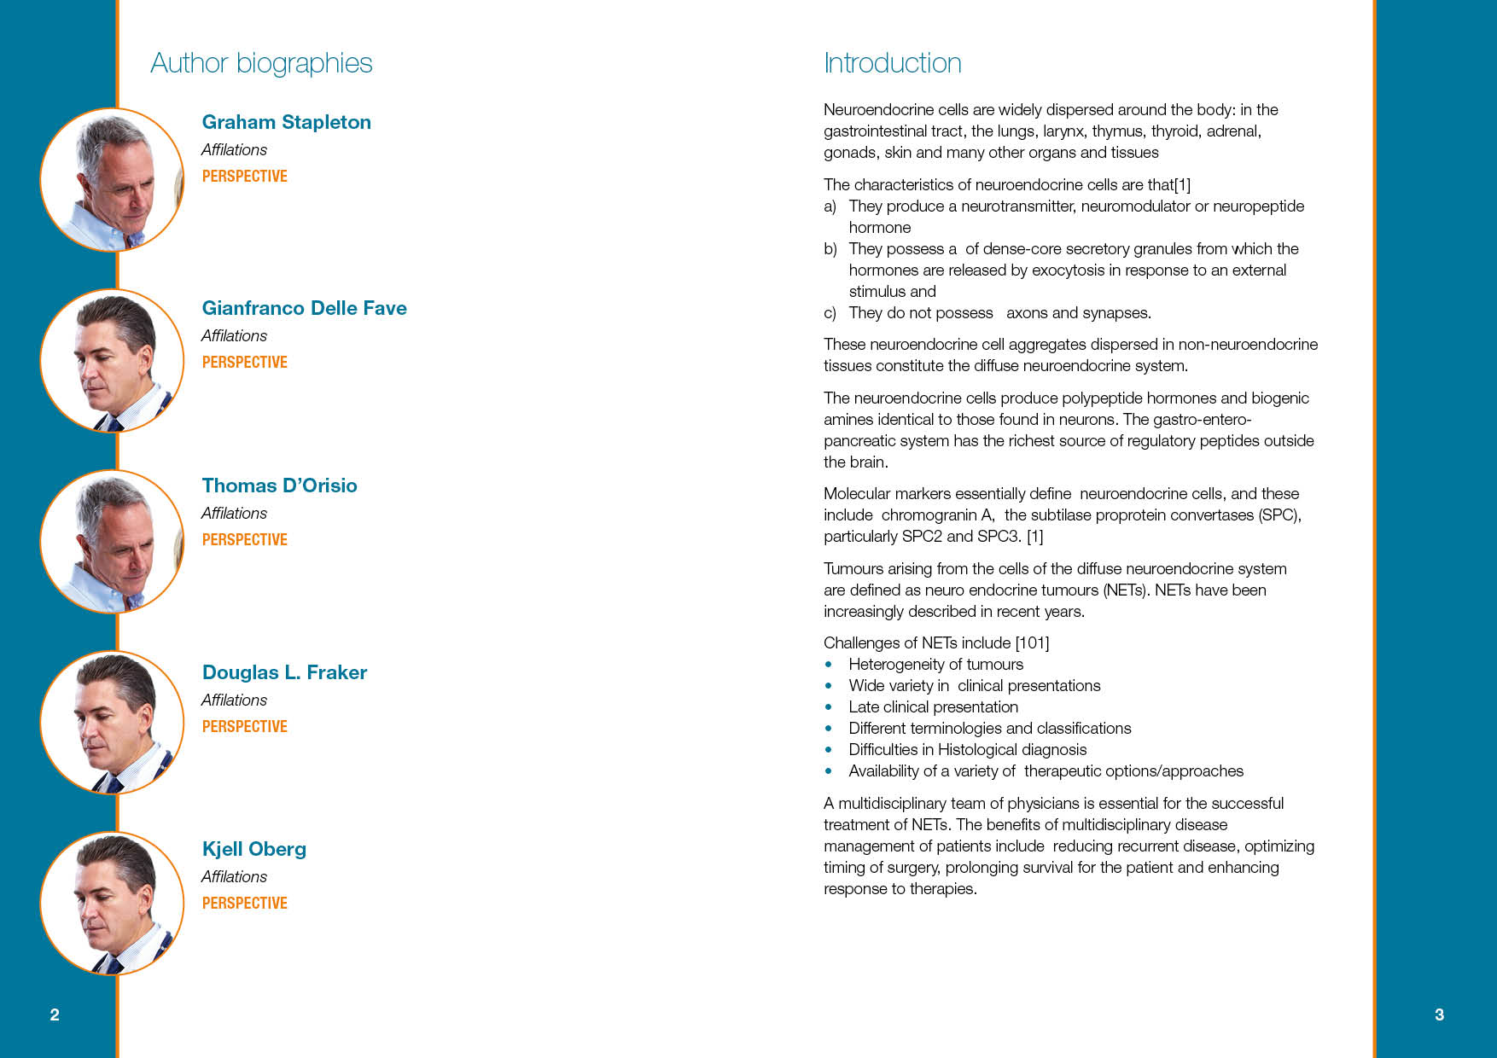
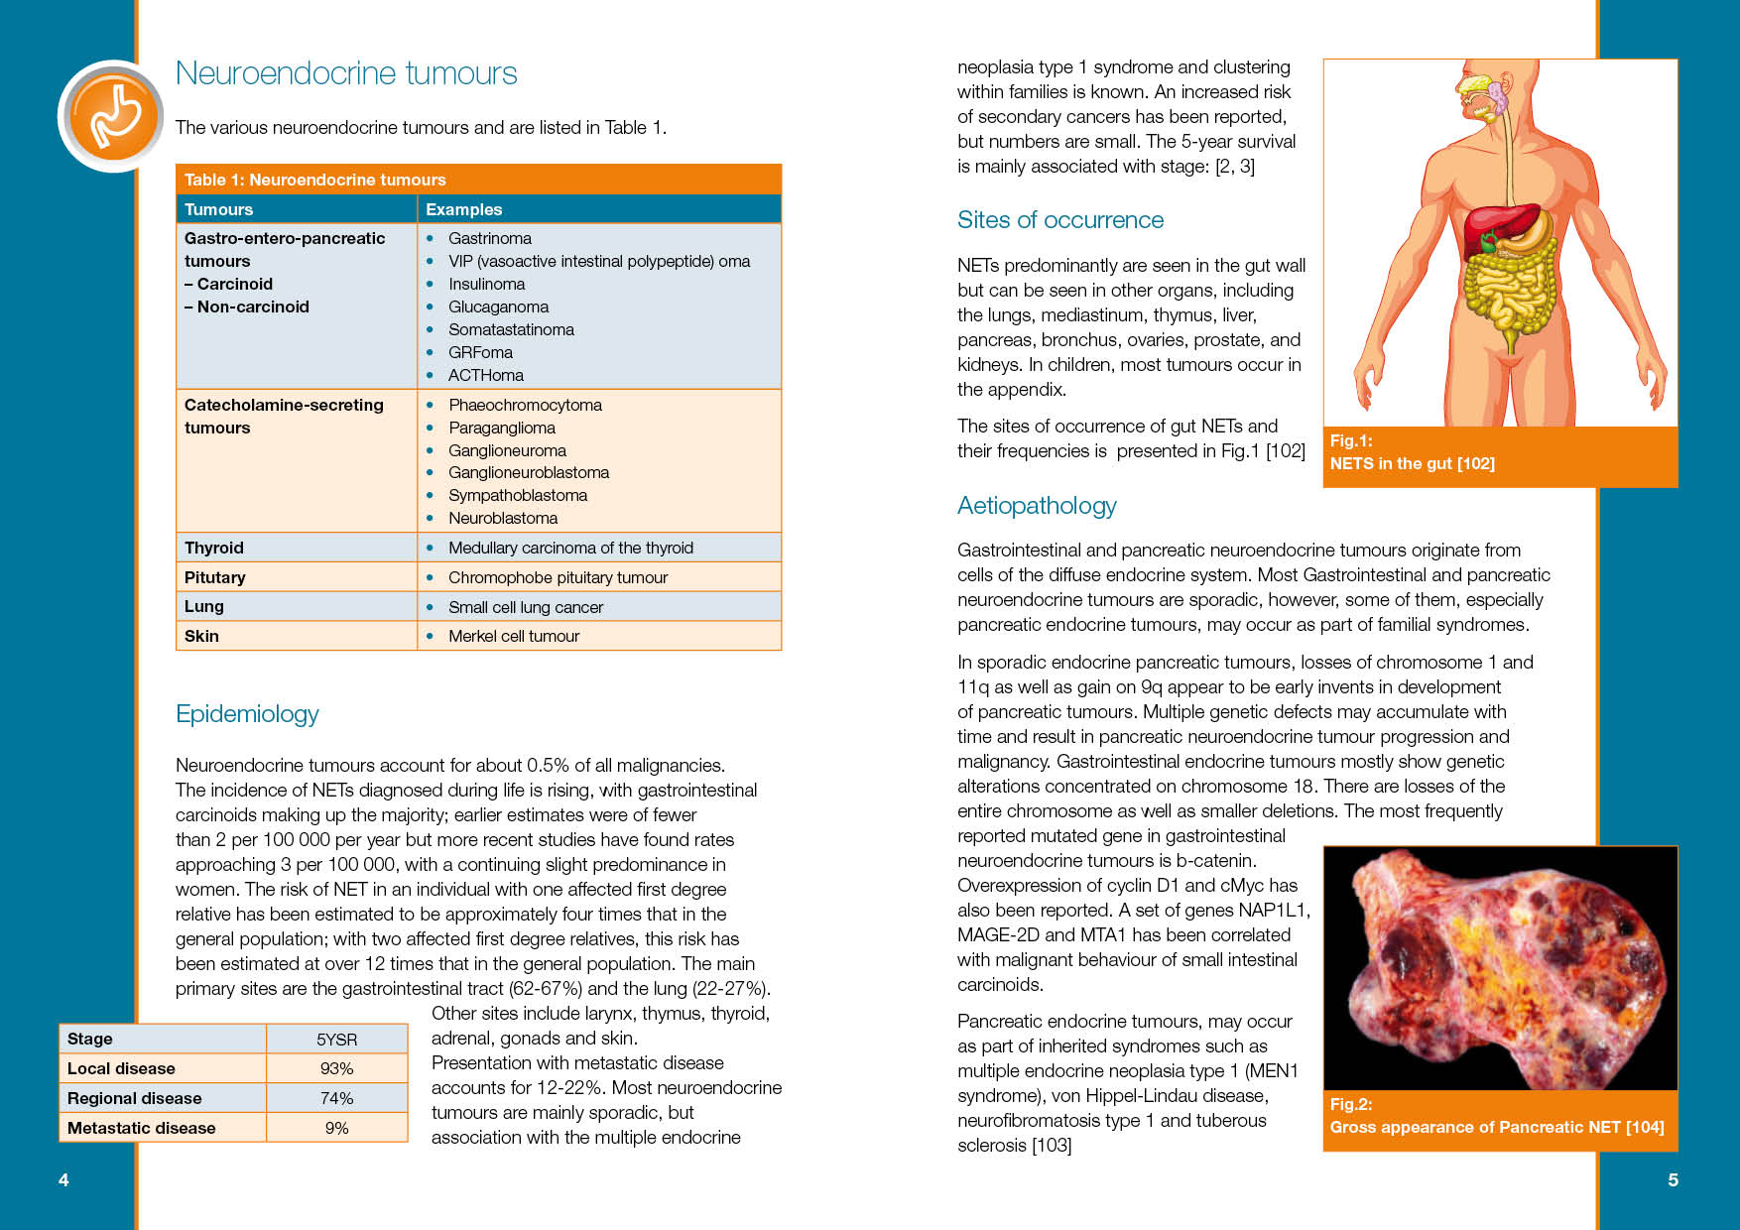
Multidisciplinary Team Management: Neuroendocrine Tumours: Sample Page Layouts

Slide 19

Products: Newsletters
Bespoke Newsletters to promote your brand at a frequency that suits you
Print and digital distribution options available
We are happy to quote according to your requirements
Format: A4, 4pp, full colour
Print and digital delivery options

Slide 20

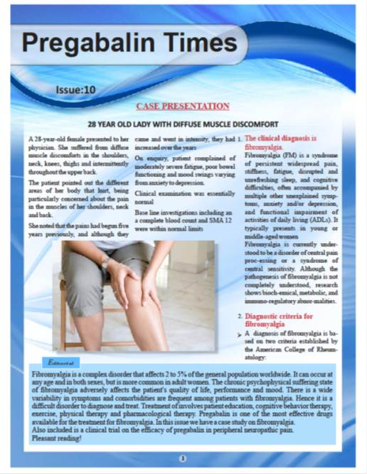
Products: Newsletters
Examples of recent client Newsletters

Slide 21

Products: Product Monographs
Healthcom Media are experienced in developing Product Monographs to suit the needs of our clients.
We are happy to provide a quote to fit your requirements
Format: A5,16pp + 4pp cover
Product Visibility: Up to 3 x Product Adverts included if required

Slide 22

Products: Product Manuals
Healthcom Media have expertise in developing Product Manuals to support your brand
Ask us for a quote
Format: A4, 16pp + 4pp cover
Product Visibility: Up to 3 x Product Adverts included if required

Slide 23
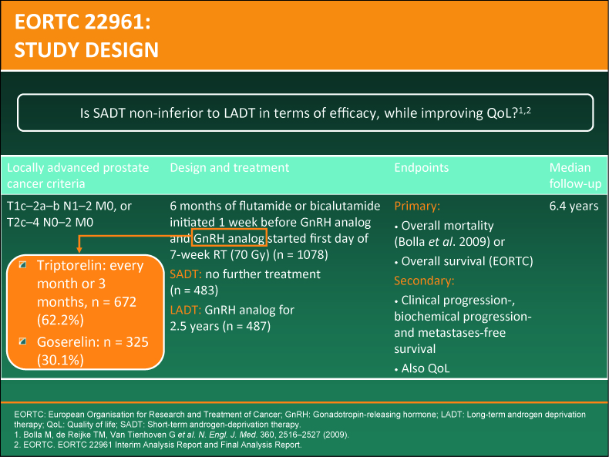
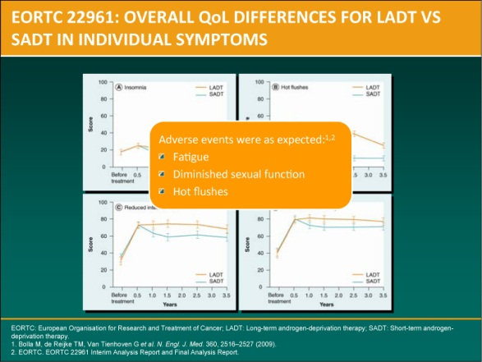
Product Training Slide Decks
Healthcom Media works can develop slides and notes to fit your strategic marketing activities and internal training programmes
Our design and editorial team work closely with you to ensure your slides are visually appealing while communicating key messages clearly and effectively

Slide 24

Products: Advances in.. Series
Healthcom Media’s series of chapter-based eBooks are
specifically designed for digital distribution.
Each chapter written by internationally renowned KOLs
Key Features
Independently peer-reviewed for academic credibility
Written for an audience of specialist audience
Providing a range of distribution opportunities:
Format: A5, 80pp approx,
full colour, Soft cover (hard cover option available)
Print and Digital Delivery Options

Slide 25
Products: Advances in.. Series
Coming Soon
Advances in Anti-Aging Therapy
Launching June 2012
Advances in HIV Management
Launching July 2012
Advances in Renal Cell Carcinoma Management
Launching June 2012
Advances in Breast Cancer Management
Launching August 2012
Advances in Diagnosis and Management of Bladder Cancer
Launching September 2012

Slide 26

Services: Meetings
Healthcom Media organises Webcasts from international meetings
We also offer traditional symposia set-ups (speaker at podium) or develop our Ask the Expert round table meeting with key international names and pose current/hot topics for discussion
Because of time differences, the webcasts will be filmed on-site at congress then produced after the event and hosted on Healthcom Media or client website.
Optional Blog or twitter feed can be associated with this activity to encourage physician feedback and interaction

Slide 27
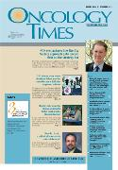


Services: Publication Planning
Healthcom Media provides a full publication planning service, as follows:
Work to your brief and offer advice and support to provide the outcomes you desire
Provide a detailed publication plan including timelines and budget
Provide expertise in developing a wide range of article types
Established relationships with a number of key journal providers (including Lippincott, Wolters Kluwer titles, BMJ)
Team of experienced in-house medical writers
Willing to work for fixed budget

Slide 28
Publication Planning: Timelines
Standard Timelines
8-12 weeks (research and medical writing of article)
3 weeks writing corrections and author liaison for
approval of draft manuscript
8-12 weeks for publication planning and submissions
We will work closely with you to ensure your landmark time frames are met within budget

Slide 29
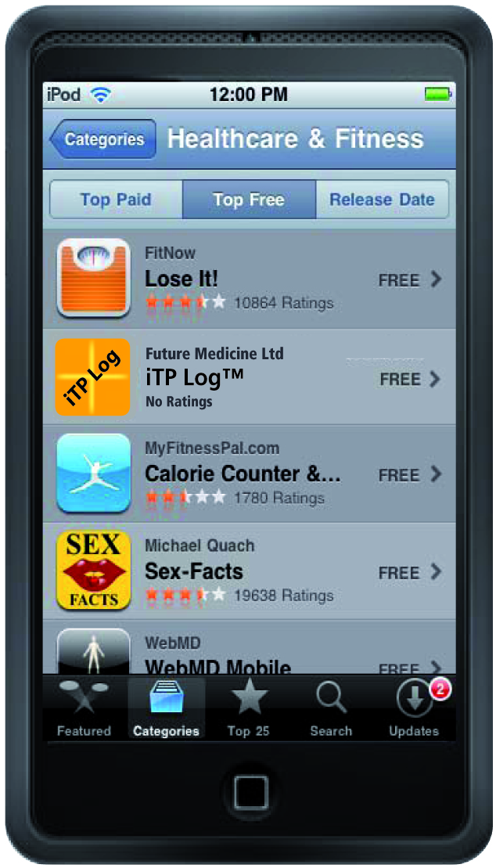

Products: Mobile Applications
Reach your target audience using new technologies
Mobile applications for Healthcare professionals and patients
Coming soon…
Pain Toolkit App

Slide 30
Access your target audience: A multi-channel approach
Print
Purchase print copies of your material for
distribution at congress, round-table meetings
or via sales representatives
Digital
Purchase a number of single-access license (SAL) codes to allow free .epub and PDF downloads via the Healthcom Media website

Slide 31

Delivery Channels: Drive Online Access to Your Content: Web key Cards
COMPUTER ACCESS (online):
User inserts the webkey into their computer
User taken direct to the Healthcom Media website
User inputs their unique single-access license (SAL) code on card
User chooses to download the .epub file (recommended for iPhone, iPad, smartphone viewing), the PDF file (recommended for desktop viewing), or both

Slide 32
Delivery Channels: Drive Online Access to Your Content: QR Code Cards
MOBILE DEVICE ACCESS (iphone, Ipad, blackberry etc.):
Scan the QR code from the QR code card
User taken direct to the Healthcom Media Website
User inputs their unique single-access license (SAL) code on card
User chooses to download the .epub file (recommended for iPhone, iPad, smartphone viewing) or PDF file (recommended for desktop viewing), or both for flexible viewing options

Slide 33
Contact
Linda Gardner
Managing Director
Healthcom Media Oxford
Tel: +44 (0) 118 2699906
Mob:+44(0) 7427624448
E: linda@healthcommedia.org

